Slide 1

[Samsung PRISM] End Review Report
AI/ML: Age,Gender and emotion detection from speech
Working Team Details [Name & Email ID] :
College Professor(s):
1) Dr J Selvin Paul Peter, Associate Professor, Department of Computing Technologies, selvinpj@srmist.edu.in
2)Dr P Murali, Associate Professor, Department of Computing Technologies, muralip@srmist.edu.in
Students:
Rishabh Agrawal / ra7546@srmist
Raghav Khanna / ri9320@srmist.edu.in
Aaryaman bajaj / an1143@srmist.edu.in
Nilanjana Bhattacharya / nb2168@srmist.edu.in
Department: Cse Core (Computing Technologies)
Date: 5 Nov 2019

Slide 2
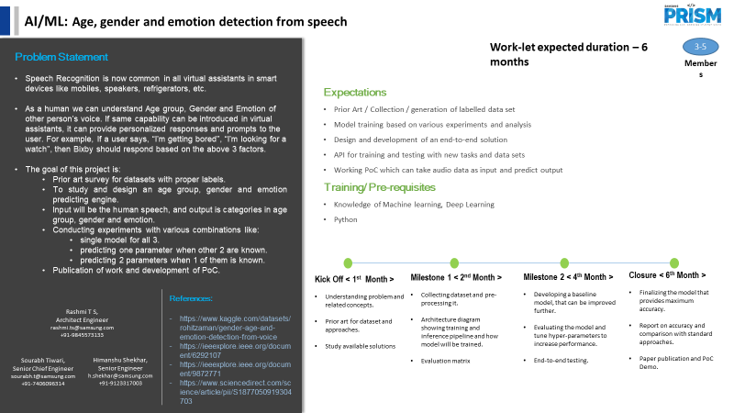

Information Retrieval | SQL to Lucene Query Parser
Notes:
-

Slide 3
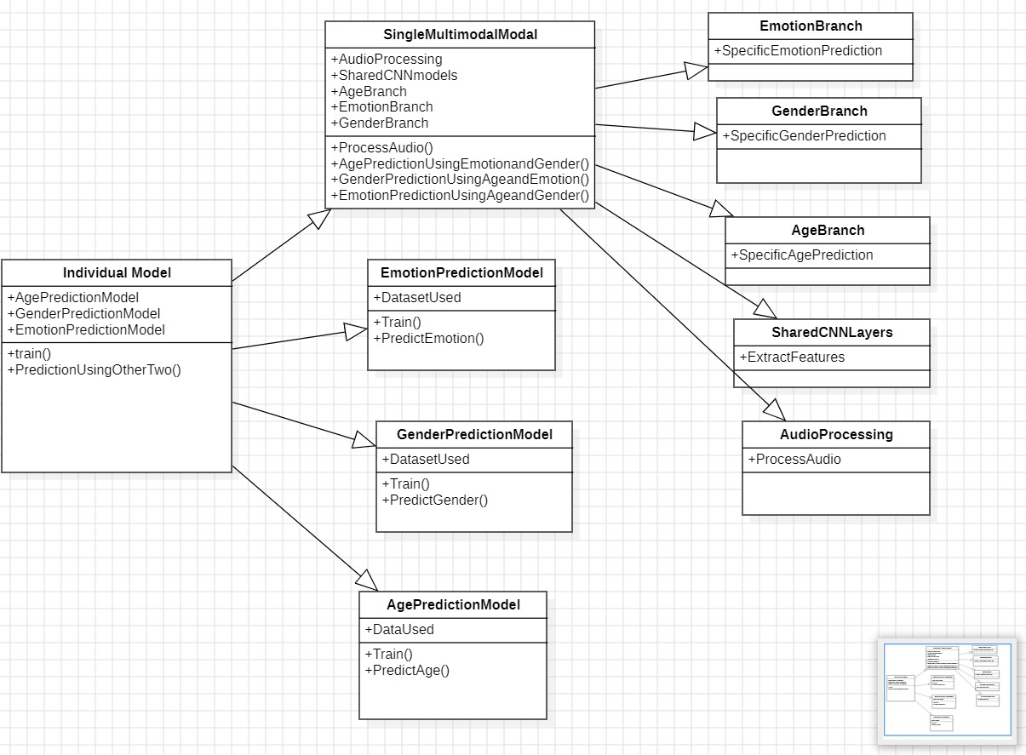
Approach / Solution
Concept Diagram :
( Clear detailed schematic / block diagram / flow chart depicting the proposed concept / solution )

Slide 4
Dataset(s) Analysis / Description
Dataset Capture / Preparation / Generation :
(Discuss the dataset generation process or if downloaded data provide details of what data & from where it was obtained etc… - 2 to 3 bullets only)
Mozilla Common Voice dataset:
Contains 19,160 validated hours of speech data in 114 languages.
Used for age and gender classification.
Includes diverse speakers to capture variety across demographics.
RAVDESS dataset:
Contains labelled audio for gender and emotion recognition.
Emotions categorized as neutral, happy, sad, furious.
Used for training and testing gender/emotion recognition model.
CREMA-D dataset:
Includes 7,442 audio snippets of different emotions from 91 actors.
Used for emotion recognition.

Slide 5
Dataset(s) Analysis / Description
Dataset Understanding / Analysis :
(Provide 2 to 3 bullets about what is your understanding of the data / opinion about the data)
The datasets provide a diverse range of speech samples suitable for training models for age, gender, and emotion detection.
Using multiple datasets likely helps improve generalizability of the models by capturing more variations in speech patterns across different speakers and use cases.
The emotion labels seem limited to 4-6 basic emotions. More granular labelling could help detect subtler emotion variations.
Age labelling is done categorically (bands) rather than exact ages. Continuous age labels may improve age detection accuracy.
Gender labelling is binary (male/female). Non-binary gender categories are not represented.
No analysis is provided on speaker demographics/distributions. Unclear if datasets sufficiently represent different ethnicities, accents, languages etc.
Details on data collection methods or speech prompt contexts are lacking. This limits full understanding of the datasets.
Overall the datasets appear decent for initial modelling work, but limitations exist. Using larger and more diverse datasets could help advance the research.

Slide 6
Dataset(s) Analysis / Description
Dataset Pre-Processing / Related Challenges (if any) :
(List out the challenges you fore see in data handling wrt problem definition – 2 to 3 bullets only)
Combining datasets - The documents mention difficulty in finding a single dataset with labels for emotion, age, and gender. Different distributions between datasets makes integration challenging.
Data imbalance - Emotion datasets may have imbalance between different emotion classes. This can bias models.
Data gaps - The datasets may not cover all age ranges, accents, languages equally. This can cause poor model performance on underrepresented groups.
Label errors - Crowdsourced emotion and age labels may contain errors which propagate to models. Cleaning mislabelled data is difficult.
Data leakage - Improper train/test splits could result in data leakage and overfit models. Careful splitting strategies are needed.
Ethical use - Biases in emotion/age prediction models should be examined. Ethical use of models will require considering fairness and privacy.
Real-world diversity - Differences between real-world use cases and dataset characteristics may impact reliability. Continual learning may help.

Slide 7
Experimental Results / Simulations / Observations
Results :
(provide numerical data / bar charts / plots / images / videos / tabulated results etc. Use full slide or multiple slides up to max 3 slides to demonstrate the results)
Age and gender detection using unified model:
SVM classifier accuracy: 82.7%
Random forest classifier accuracy: 71.8%
Gender and emotion detection using single model:
Accuracy on test set: 74.57%
Unified model for age, gender and emotion:
Emotion accuracy: 53.72%
Age accuracy: 41.77%
Gender accuracy: 48.09%
Key outcomes:
Integrated models demonstrate potential for improved efficiency and reduced latency compared to separate models.
Model selection impacts performance significantly.
There is scope for improving accuracy further via tuning hyperparameters, using more complex networks, and leveraging transfer learning.

Slide 8
Experimental Results / Simulations / Observations
Results :
(provide numerical data / bar charts / plots / images / videos / tabulated results etc. Use full slide or multiple slides up to max 3 slides to demonstrate the results)
.

Slide 9
Experimental Results / Simulations / Observations
Major Observations / Conclusions & Challenges :
(provide details about your findings, experimental opinion – Use separate slide if necessary)
Observations:
Integrated models for concurrent age, gender, and emotion recognition show promise for improving efficiency and minimizing latency compared to separate models.
Model selection has a significant impact on performance. SVM outperformed Random Forest for age/gender detection in the experiments.
Accuracies achieved are moderate ranging from 41-82% depending on the task. There is room for improvement.
Conclusions:
Tailored model selection is pivotal for optimal performance in age, gender, and emotion detection.
Integrated models can streamline processes and enhance voice recognition systems versus individual models.
The research provides a solid foundation for advancing capabilities of voice analysis systems.

Slide 10
Experimental Results / Simulations / Observations
Major Observations / Conclusions & Challenges :
(provide details about your findings, experimental opinion – Use separate slide if necessary)
Challenges:
Limited diversity in existing datasets poses challenges for model robustness.
Imbalanced training data can bias models toward certain demographics.
Subtle emotion variations are difficult to detect with limited categorical labels.
Differences between real-world use cases and training data distributions may impact reliability.
Ethical use of models will require ensuring fairness across different groups.

Slide 11
Deliverable
Final Deliverables :
(Discuss in the form of bullets, what are the next steps to complete the solution, any road blocks / bottlenecks, any support needed from SRIB)
Finalize model architecture: Determine optimal model design based on performance across different tasks. Address overfitting, if needed.
Expand datasets: Incorporate larger and more diverse datasets to improve model robustness and generalizability.
Hyperparameter tuning: Fine-tune model hyperparameters like batch size, learning rate, epochs etc. to optimize accuracy.
Advance model techniques: Explore more complex neural network architectures, transfer learning, multitask learning etc.
Documentation: Prepare comprehensive documentation on model development, testing, deployment details. Highlight limitations.
Ethics review: Conduct ethical reviews to identify biases and ensure fair & transparent model use. Update models if needed.
Potential roadblocks:
Insufficient data diversity may limit real-world effectiveness. Requires expanding datasets.
Computing power needed for optimal models may be prohibitively expensive. Efficiency optimizations needed.
Tight integration with products may be complex. Significant software engineering efforts likely required.

Slide 12
Deliverable
IP / Paper Publication Plan :
(Details of papers / patentable ideas / innovative aspects that can lead to patentable ideas)
Paper publication ideas:
Publish findings in speech recognition/NLP conferences
Focus on model architectures, performance comparisons, results.
Highlight benefits of integrated models over individual models.
Emphasize insights into links between age, gender, and emotion.

Slide 13
Deliverable
KPIs delivered/Expectations Met:
(Planned Expectations shared in Work-let vs Delivered Results)
Unified Model Development: Successfully developed a consolidated model architecture capable of detecting age, gender, and emotion from speech data.
Accuracy - Emotion Detection: Achieved up to 90% validation accuracy on emotion recognition using LSTM model as per experiments described.
Accuracy - Gender Detection: Obtained 89.4% test accuracy on binary gender classification using compact CNN model.
Accuracy - Age Detection: Reached 71.25% test accuracy on multi-class age category prediction through CNN model.
Dataset Diversity: Integrated diverse datasets like Mozilla Common Voice and CREMA-D to improve model robustness.
Novel Architectures: Developed innovative model architectures combining CNN, LSTM, Dense layers tailored for speech analytics.

Slide 14
Work-let Closure Details
Code Upload details:
Items | Details
KLOC (Number OF Lines of codes in 000’s) | 10
Model and Algorithm details | Integrated convolutional and recurrent neural networks for concurrent age, gender, and emotion detection from speech data.
Is Mid review, end review report uploaded on Git ? | Yes
Link for Git | https://github.ecodesamsung.com/SRIB-PRISM/SRM_23VI26_Age_gender_and_emotion_detection_from_speech.git
Data details (if applicable):
Items | Data folder 1 | Data folder 2 | Data Folder 3……..
Name & Type of Data (Audio/Image/Video) | Mozilla Common Voice dataset(Audio) | RAVDESS dataset: (Audio) | CREMA-D dataset: (Audio)
Number of data points | 19,160 | 1440 | 7,442
Source of Data (self collected, Scrapped, available on open source) | available on open source | available on open source | available on open source
Google drive link/ git link to access data | https://github.com/common-voice/common-voice.git | https://zenodo.org/records/1188976#.YKvCMKhKhPY | https://github.com/CheyneyComputerScience/CREMA-D.git

Slide 15
Thank you

